Slide 1
Event Marker
A Simple Offline Desktop Application

Slide 2
Event Marker
Project Domain
Organization Name
External Organization
Hope Public Charitable Trust, Chennai.
www.hopechennai.com

Slide 3
External Organization Info
Hope Public Charitable trust is a Non-Governmental organization, active since 2007.
Headquartered at Chennai, India, we strive to address the needs, living conditions of the intellectually challenged community, which is one of the most marginalized in our society.
HOPE strives to improve the living conditions of challenged community by providing Special Education, Vocational training and Rehabilitation services for the intellectually impaired, and Special needs children and adult .

Slide 4
Abstract
This project aims to create an offline desktop application that allows users to record and manage information about individuals who are willing to donate food to a trust or organization.
The app will feature CRUD (Create, Read, Update, and Delete) functionality, allowing users to easily add, view,edit, and remove donor information.
The app will be designed to work offline, allowing users to use it in areas where internet connectivity is unreliable or unavailable.
The goal of the app is to provide a convenient and efficient way for trusts and organizations to track and manage donations, helping them to better serve their communities.

Slide 5
Team Member
Internal Guide – Mr. P. Chandrasekar (Head Of The Dept)
Abu Obaidah Z – Backend Developer,
Software – MERN stack (Mongodb, Express.js, React.js, Node.js)
Ranjith E – Frontend Developer
Software – HTML & CSS
Balaji S – Testing & Documentation
Software – MS Office Suit, End Product Testing

Slide 6
Project Usecase:
Event markers assist in the organisation of people’s information. It effectively organises the details by providing information and their reserved slots It will not permit reserving a slot once it is already reserved for a particular

Slide 7
Problem Faced By The Organization
﻿Limited Storage Capacity: Books have limited storage capacity, and after a certain point, new information cannot be added without creating a new book. This can result in the need for multiple books, which can be difficult to manage and organize.
Vulnerability to Damage: Books are vulnerable to damage, such as fire, water, or other natural disasters, which can result in the loss of important data. Even if data is backed up, the original book cannot be replaced.
Difficulty in Searching and Retrieving Information: Finding specific information in a book can be time-consuming and difficult, especially if the data is not organized in a structured way. This can be a major disadvantage in cases where quick access to information is essential.
Lack of Accessibility: Books may not be easily accessible to everyone who needs to access the data, as they may be stored in a physical location that is not convenient for everyone. This can create barriers to collaboration and hinder the sharing of information.

Slide 8
Benefits Of Event Marker
Our app comes with powerful features such as sorting, filtering, and searching, which allow you to easily find the information you need. The database for the app is local MongoDB Compass, which is a highly flexible and scalable NoSQL database solution. With our app, you can add new donors, view and edit existing information, and delete records that are no longer needed. Our user-friendly interface makes it easy to navigate and perform CRUD operations, saving you time and effort. Our app will help you to better serve your community by managing donations more effectively.

Slide 9
Organization’s Requirements
Our app is designed to help trusts and organizations schedule food donations effectively by providing a system to track and manage 5 different food slots: morning snack, breakfast, lunch, evening snacks, and dinner. Each slot can be booked for a specific date, and once a slot is booked for a date, it cannot be booked by others for that same date. The aim of this feature is to help trusts and organizations to schedule the food slots effectively and to avoid the overlapping of food slots on the same date. With the ability to view and manage all the food slots in one place, it makes it easy for trusts to plan their donations in advance and ensure that there is always enough food to meet the needs of their community. This will help trusts to schedule the food donations more efficiently, and to ensure that they always have enough food to meet the needs of their community.

Slide 10
Software Requirements
Node.js - a JavaScript runtime environment for server-side scripting.
MongoDB - a NoSQL database used to store application data.
Express - a web framework for Node.js that makes it easier to handle HTTP requests and routes.
React - a JavaScript library for building user interfaces.
Electron - a framework for building desktop applications with web technologies (HTML, CSS, and JavaScript).

Slide 11
Hardware Requirements
Processor: A modern multi-core processor with a clock speed of 2 GHz or higher.
RAM: 4 GB or more of RAM is recommended.
Storage: A solid-state drive (SSD) with a minimum of 100 GB of storage is recommended.
Graphics: A dedicated graphics card is not necessary, but it may be beneficial if your application involves intensive graphics or visualizations.
Operating System: A recent version of Windows, MacOS, or Linux.

Slide 12
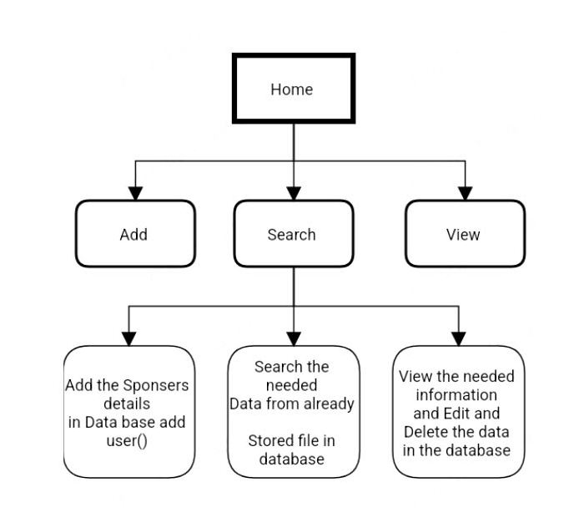
Design
LEVEL 0

Slide 13
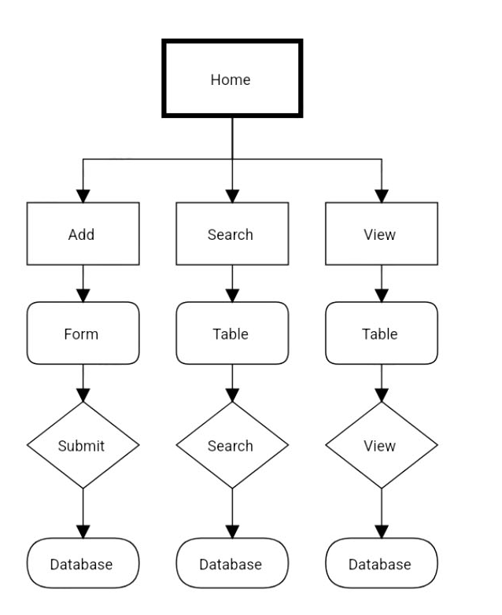
Design
LEVEL 1

Slide 14
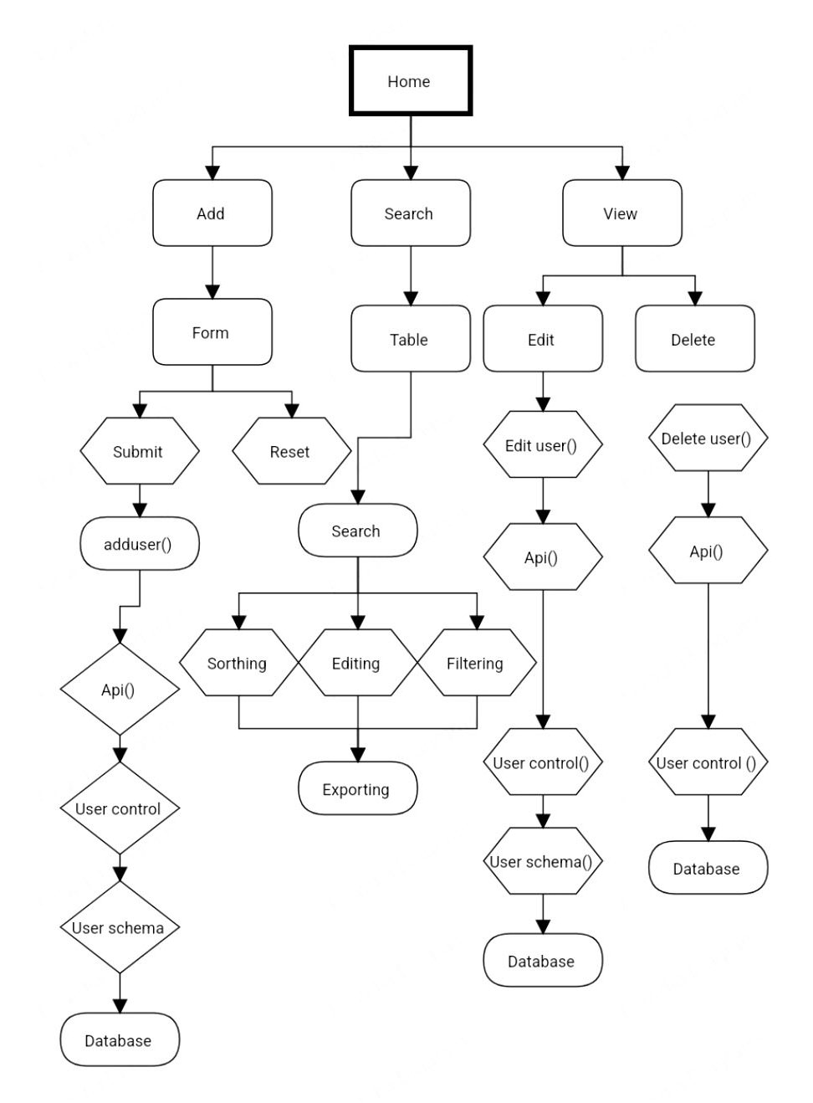
Design
LEVEL 2
Sorting

Slide 15
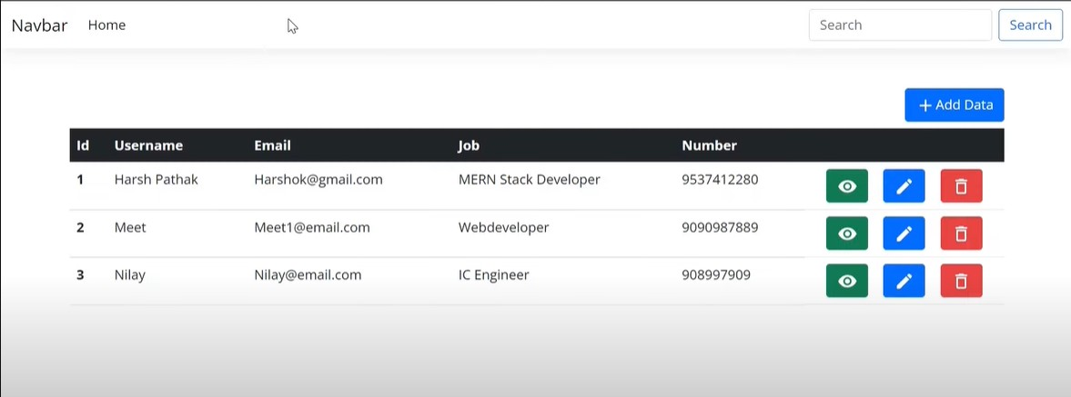
Reference
Source : YouTube / HarshPathak & openAI Chat

Slide 16
TYPES OF TESTING
Software performance testing
Functional testing
Security testing
CRUD Testing

Slide 17
CRUD TESTING FOR OUR PROJECT
Testing of all CRUD (Create, Read, Update, and Delete) operations is essential to ensure the application is functioning as expected and to catch any bugs early in the development process.
It is important to test each CRUD operation individually, as well as testing them in combination. This will help to identify any dependencies or interactions between the operations that may cause unexpected results.

Slide 18
WHY CRUD TESTING ?
Improved Data Integrity
Better User Experience
Increased Security
Reduced Risk
Improved Performance

Slide 19
CRUD TESTING EXAMPLE
Details | Create (Pass/fail) | Read (Pass/fail) | Update (Pass/fail) | Delete (Pass/fail)
Customer | P | P | P | P
Order | P | P | P | P
Payment | P | P | P | F
Vendor | P | P | P | P

Slide 20
Electron.js
Electron is a framework for building desktop applications using web technologies such as HTML, CSS, and JavaScript. It allows developers to create cross-platform desktop applications that run on Windows, MacOS, and Linux.
Electron combines the Chromium rendering engine and Node.js runtime environment, allowing developers to build desktop applications with access to the full suite of Node.js modules and the ability to display web content using Chromium.
Electron's use of web technologies makes it a popular choice for developers who are already familiar with these technologies and want to build desktop applications.

Slide 21
Conclusion
Slot Booking Algorithm : To avoid booking slots which already booked
Admin Login : To make the app secure by adding Admin Login page with Password
Dashboard : To show current date updates like Total Entries Made, Current Slots Booked, Current Empty Slots.
Conversion : To Convert Web app into Desktop app which can be installed and used in windows

Slide 22
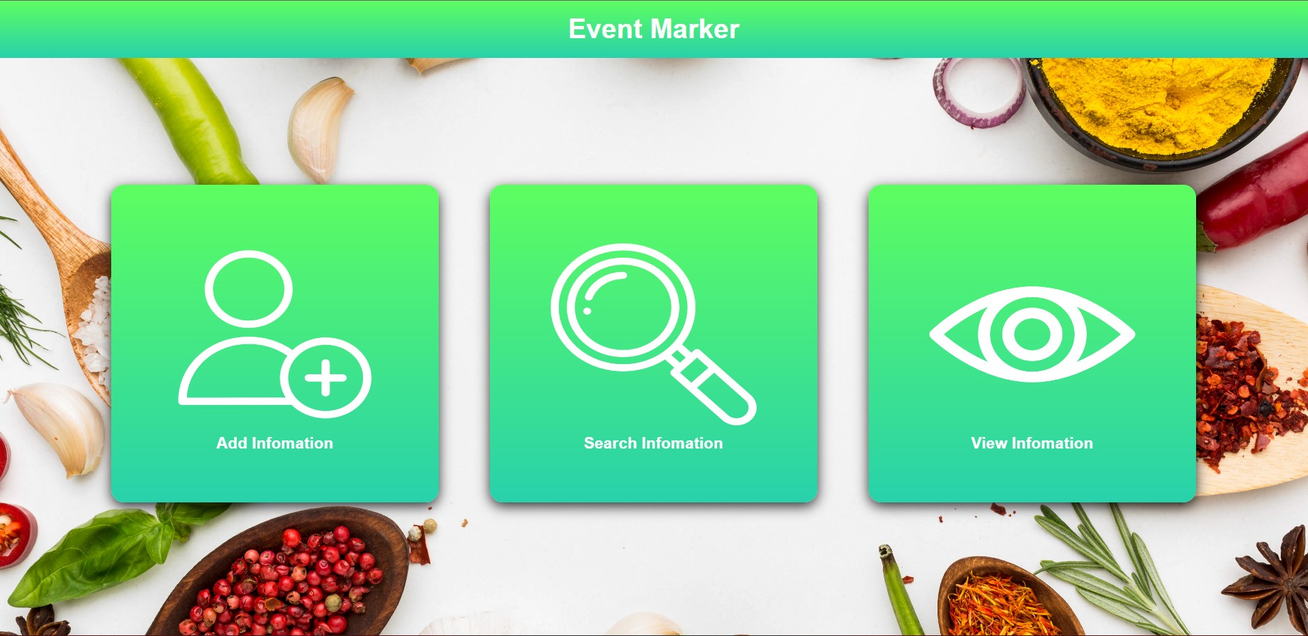

Slide 23
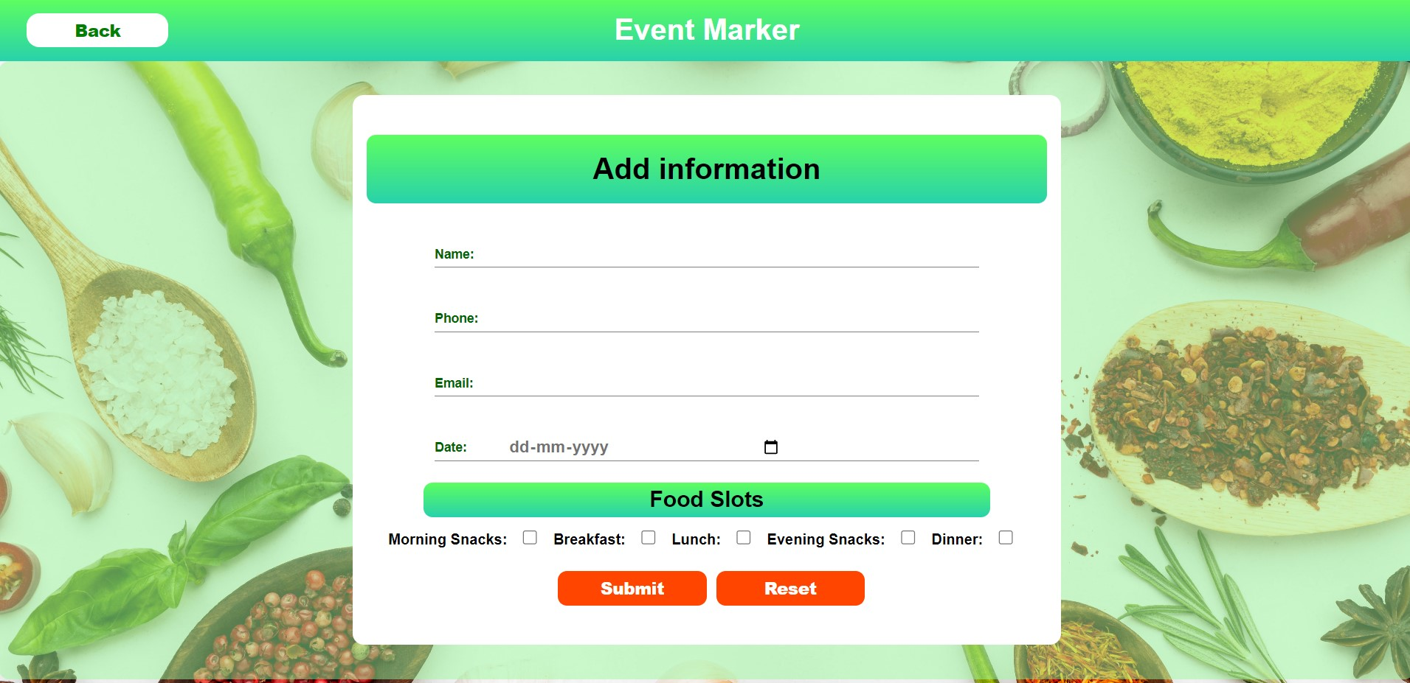

Slide 24
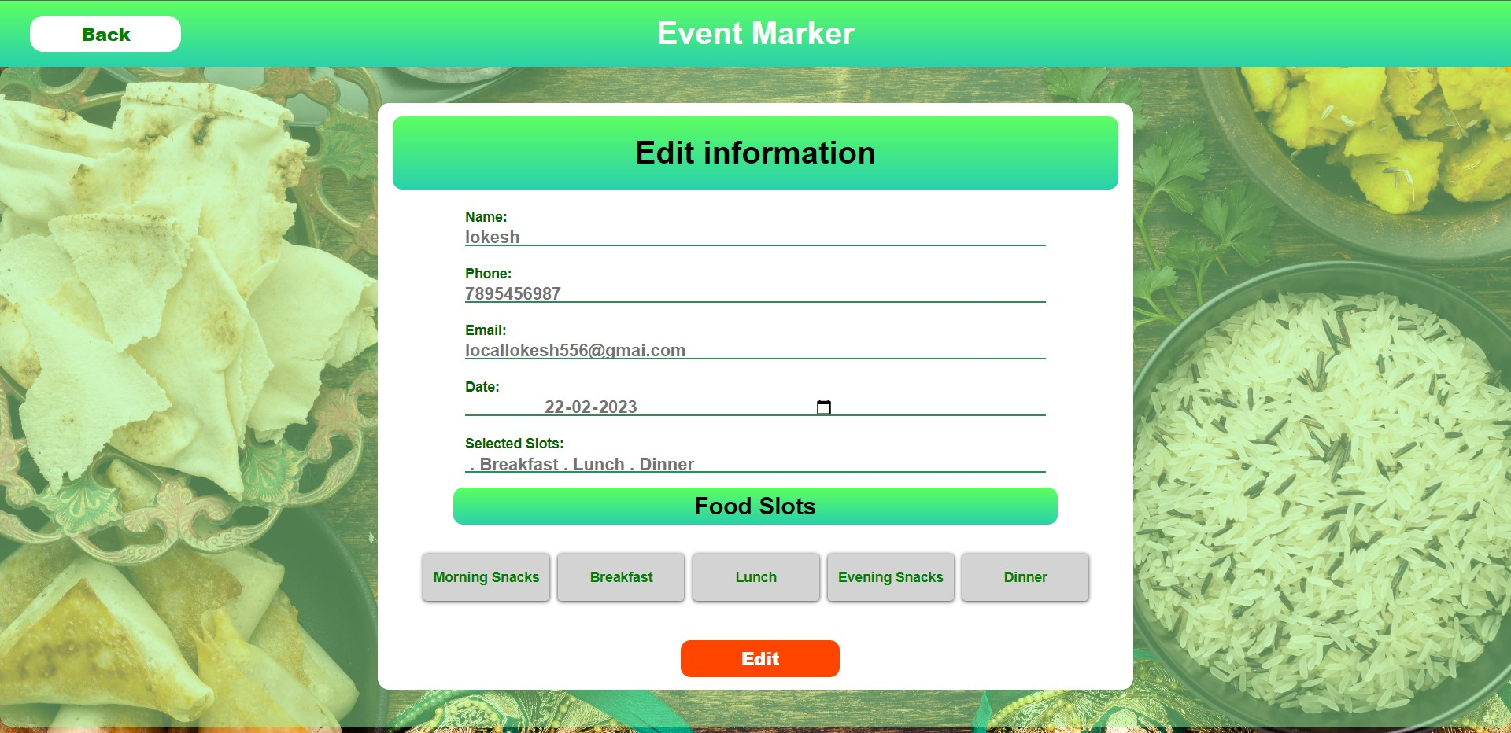

Slide 25
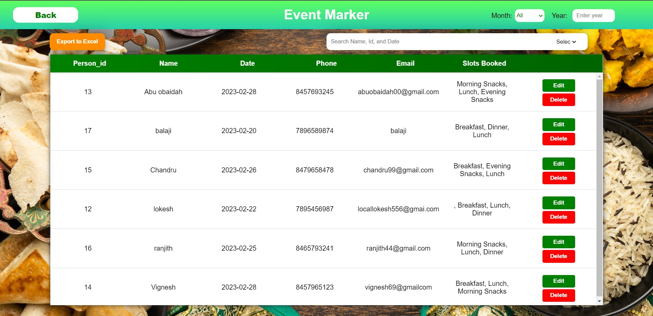

Slide 26
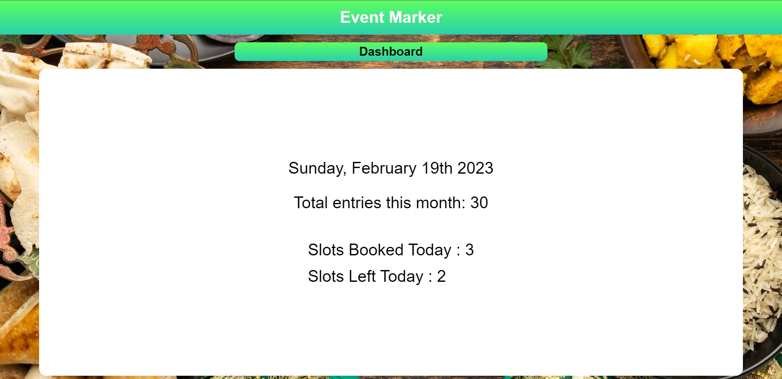

Slide 27
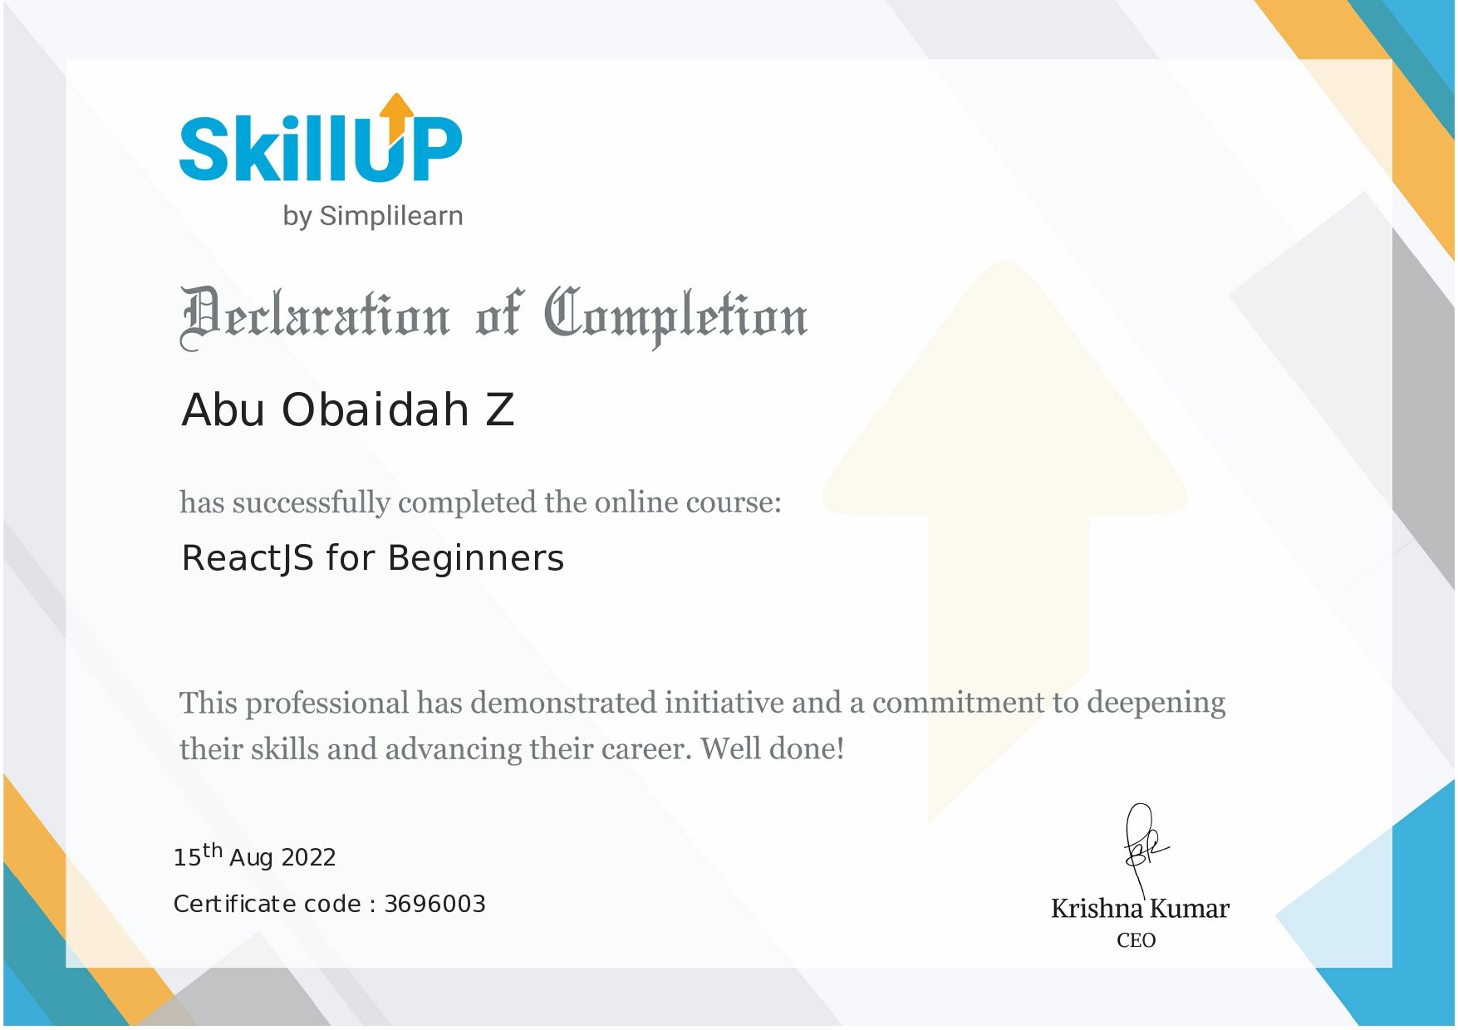

Contribution
Abu Obaidah Z – React, Javascript, Electron.js, Mongodb
Ranjith E – HTML & CSS
Balaji S – Ms Office & CRUD testing
Certificates

Slide 28
Thank You

